Slide 1
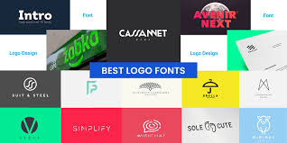
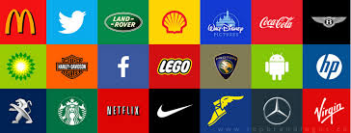
Logo Design: Creating Memorable Brand Identities

Slide 2
What is a Logo?
A logo is a visual symbol representing a brand
It's the face of a company or organization
Logos combine text, images, or both
Purpose: To create instant brand recognition
Examples: Apple's apple, Nike's swoosh, McDonald's golden arches

Slide 3

Why Logos Matter
First impression for potential customers
Builds trust and credibility
Helps stand out from competitors
Fosters brand loyalty
Communicates brand values and personality
Memorable logos stick in people's minds

Slide 4
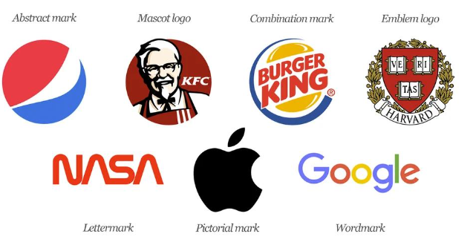
Types of Logos
With millions of logos worldwide, you may be surprised that they all fit into one of seven main categories.
Emblem: incorporating text within a symbol (e.g. Harvard University)
Wordmarks - text-based logos
(e.g., Google, Coca-Cola)
Lettermarks use initials to create a concise logo (e.g., IBM, CNN)
Pictorial marks rely on a single image to represent a brand (e.g., Twitter bird, Apple apple)
Abstract logo marks geometric forms and colors instead of real-life images (e.g., Pepsi, Adidas)
Mascots - illustrated characters to personify a brand (e.g., KFC's Colonel Sanders)
Combination marks (text + symbol, e.g., Burger King)

Slide 5

Key Elements of Logo Design
Simplicity: Easy to recognize and remember
Versatility: Works in different sizes and formats
Timelessness: Avoids trendy designs that may age quickly
Appropriateness: Fits the brand and industry
Memorability: Stands out and leaves an impression
Uniqueness: Differentiates from competitors

Slide 6

Color in Logo Design
Colors evoke emotions and associations
  Red: excitement, passion (Coca-Cola, Netflix)
  Blue: trust, professionalism (Facebook, IBM)
  Green: growth, nature (Whole Foods, Android)
  Yellow: optimism, clarity (McDonald's, Snapchat)
Consider color psychology when choosing logo colors

Slide 7
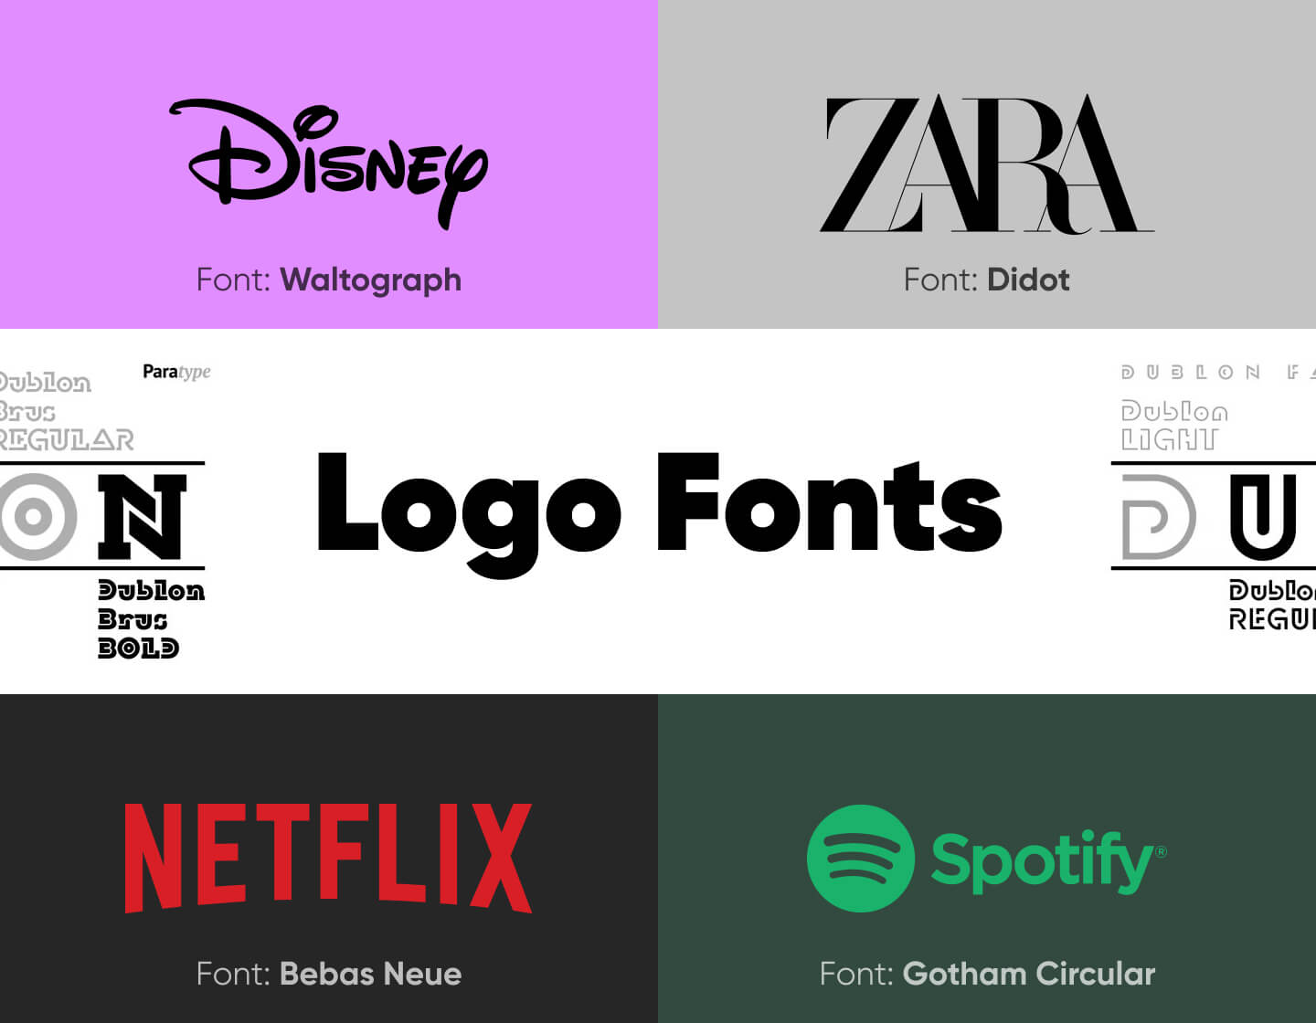
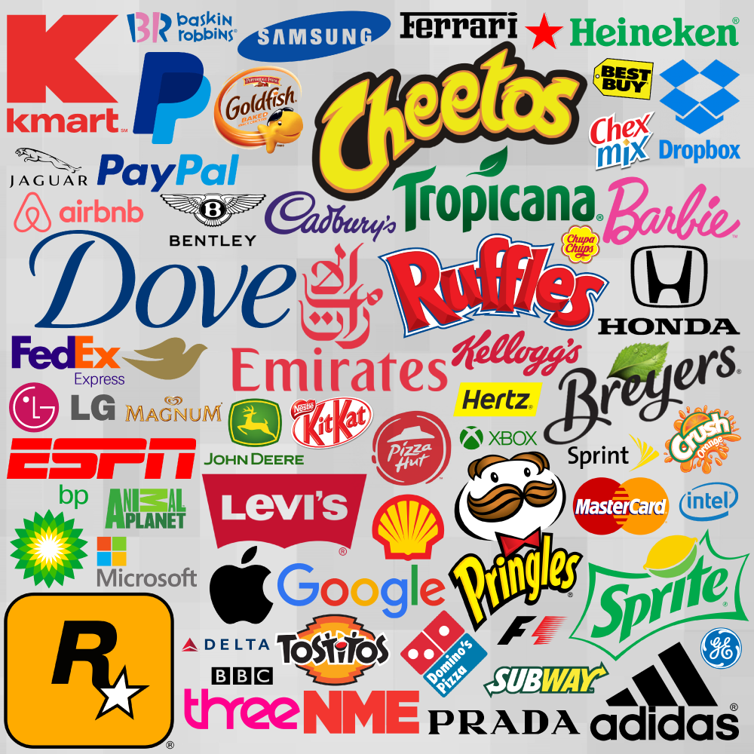
Fonts in Logo Design
Font choice affects brand perception
Serif fonts: traditional, respectable
(Times New Roman)
Sans-serif fonts: modern, clean (Arial, Helvetica)
Script fonts: elegant, creative
(Coca-Cola)
Display fonts: unique, eye-catching (Disney)
Custom typography can make logos more distinctive

Slide 8

Logo Design Best Practices
Keep
Keep it simple and memorable
Ensure
Ensure it's scalable – can be used in print, social media, and websites. Can be small, medium or large for billboards etc. In essence it me be available for various uses
Make
Make it work in black and white
Avoid
Avoid copying other logos
Test
Test the logo in different contexts
Get
Get feedback from others - three responses to a piece of design — yes, no, and WOW!
Consider
Consider how it will look on products and marketing materials

